Slide 1
DBMS Serial Schedule

Slide 2
Serial Transaction/ Execution
All transactions execute serially one after the other.
When one transaction executes, no other transaction is allowed to execute.

Slide 3
Characteristics-
Serial schedules are always-
Consistent
Recoverable
Cascadeless
Strict

Slide 4
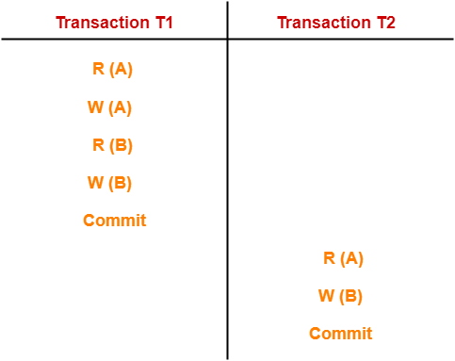

Slide 5
In this schedule,
There are two transactions T1 and T2 executing serially one after the other.
Transaction T1 executes first.
After T1 completes its execution, transaction T2 executes.
So, this schedule is an example of a Serial Schedule.

Slide 6
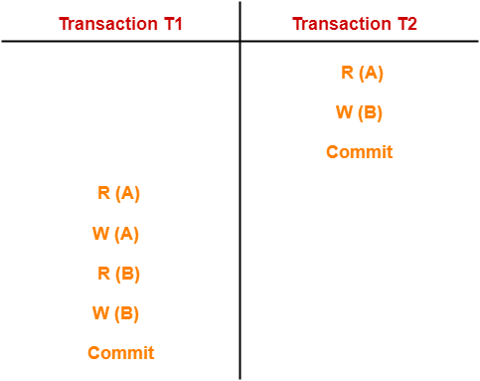

Slide 7
In this schedule,
There are two transactions T1 and T2 executing serially one after the other.
Transaction T2 executes first.
After T2 completes its execution, transaction T1 executes.
So, this schedule is an example of a Serial Schedule.

Slide 8
Consider two transactions T1 and T2
Transaction T1: deposits rs.100 to both accounts A and B
Transaction T2: doubles the balance of accounts of A and B

Slide 9
Read(A)
A <- A+100
Write(A)
Read(B)
B <- B+100
Write(B)
Read(A)
A <- A*2
Write(A)
Read(B)
B <- B*2
Write(B)
T1
T2

Slide 10
Executing T1 after T2
T1 | T2 | A | B | Operations
 |  | 25 | 25 | Initial balance
 | Read(A)
 | A <- A*2
 | Write(A) | 50
 | Read(B)
 | B <- B*2
 | Write(B) | 50 | 50
Read(A)
A <- A+100
Write(A) |  | 150
Read(B)
B <- B+100
Write(B) |  | 150 | 150

Slide 11
Executing T2 after T1
T1 | T2 | A | B | Operations
 |  | 25 | 25 | INTIAL BALANCE
Read(A)
A <- A+100
Write(A) |  | 125
Read(B)
B <- B+100
Write(B) |  | 125 | 125
 | Read(A)
 | A <- A*2
 | Write(A) | 250
 | Read(B)
 | B <- B*2
 | Write(B) | 250 | 250

Slide 12
Thank you !

